Slide 1
Does Rethinking Text as Vision Allow us to Scale LLMs Better?
DeepSeek-OCR: Contexts Optical Compression
Glyph: Scaling Context Windows via Visual Text Compression
Authors:
Wei et al. @ DeepSeek
Cheng et al. @ Tsinghua University

Slide 2
Outline
Background: OCR and VLMs
Glyph: Introduction & Motivation
Glyph: Method & Novelty
Glyph: Results
DeepSeek OCR: Introduction & Motivation
DeepSeek OCR: Method & Novelty
DeepSeek OCR: Results
Discussion and Open Questions

Slide 3
Some Background

Slide 4
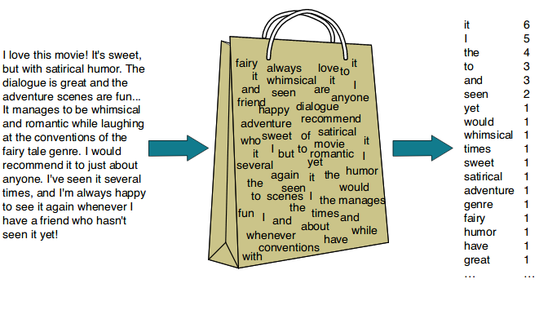
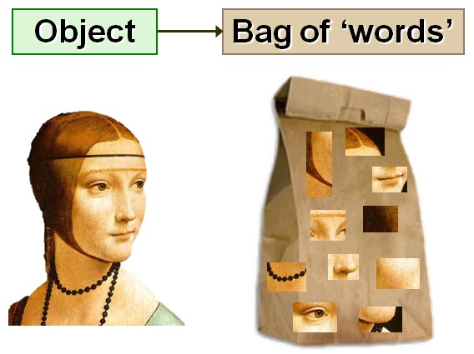
Long Context Problem
The Problem: Long context problem.
OOD for the model. (performance drop).
Inference cost increase.
GPU CUDA memory limit.
Solutions:
Extend position encoding. e.g. YaRN
KV cache eviction, sparse attention.
OCR: compress text into visual tokens. ← Today’s papers
Visual Tokens vs Text Tokens:
A picture have many patches, each patch has its own “local” semantic (i.e. a cat, a table edge), and have dependencies / connections in between. This is similar to tokens in natural language.
=> We can treat image as “bag of word”

Slide 5
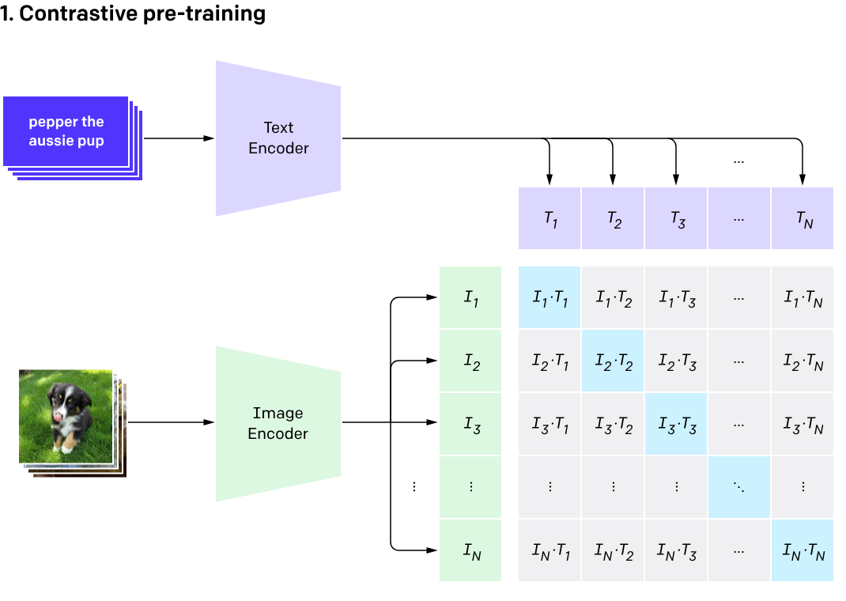
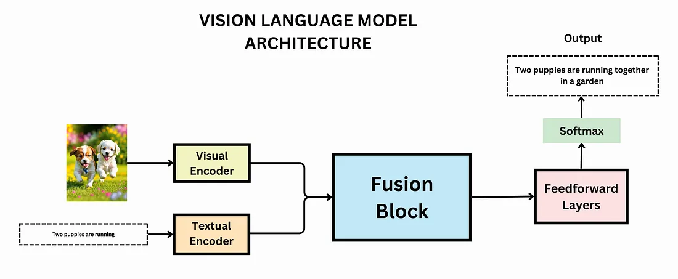
Background: VLM
We have good text LLM already. Can we leverage natural language data to understand image?
Key: Representation can be shared shared.
Solution: Align visual token (of an image) to word token (of the caption) via contrastive pretraining. (=>CLIP)
Then we can fuze the visual encoder and the text encoder and just use a single LLM . (VLM)
Now with a VLM, what can we get?
=> Generic image understanding.
-> OCR ability!
-> Can we represent text as image? Just like how human read books.

Slide 6
Glyph: Scaling Context Windows via Visual Text Compression

Slide 7
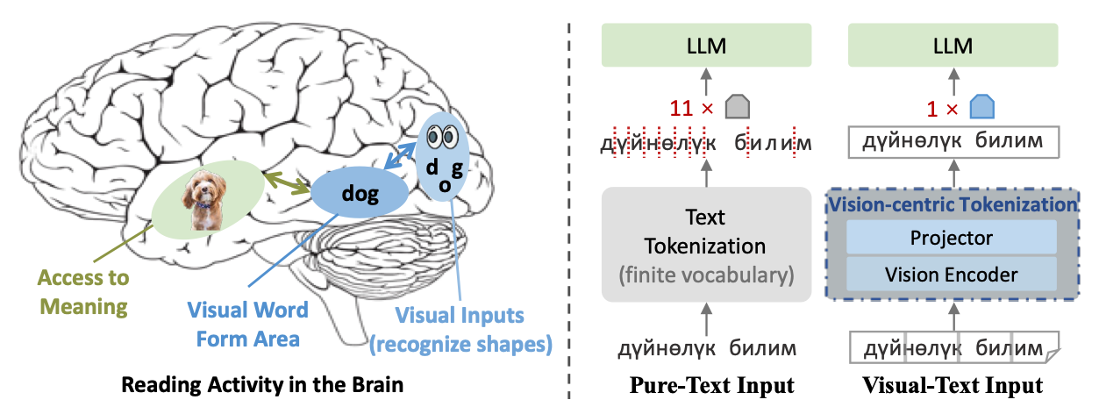
Glyph: Introduction
Motivating the Problem
Reading isn’t a character-by-character computation; the visual stream aggregates shapes into word forms that the linguistic stream maps to meaning.
Pure text tokenizers ignore this pipeline and over-segment (especially across scripts and morphologies), inflating sequence length with units that are visually redundant.
If we let the model ingest the visual bundles directly, a few visual tokens can carry the same semantic payload as many subwords—compressing context without discarding meaning.
Why Current Solutions Don’t Work!
Extractive prompt compression (LLMLingua family): Removes “less important” tokens to hit budgets; helpful but task-dependent.
Context-extension via RoPE scaling (YaRN / NTK-aware): Increases the window size but doesn’t reduce tokens—compute and memory still grow with the raw sequence length.
Analogy from prior work: Visual processing can aggregate shape/word cues into fewer units: used here only to motivate Glyph’s visual-text compression.

Slide 8
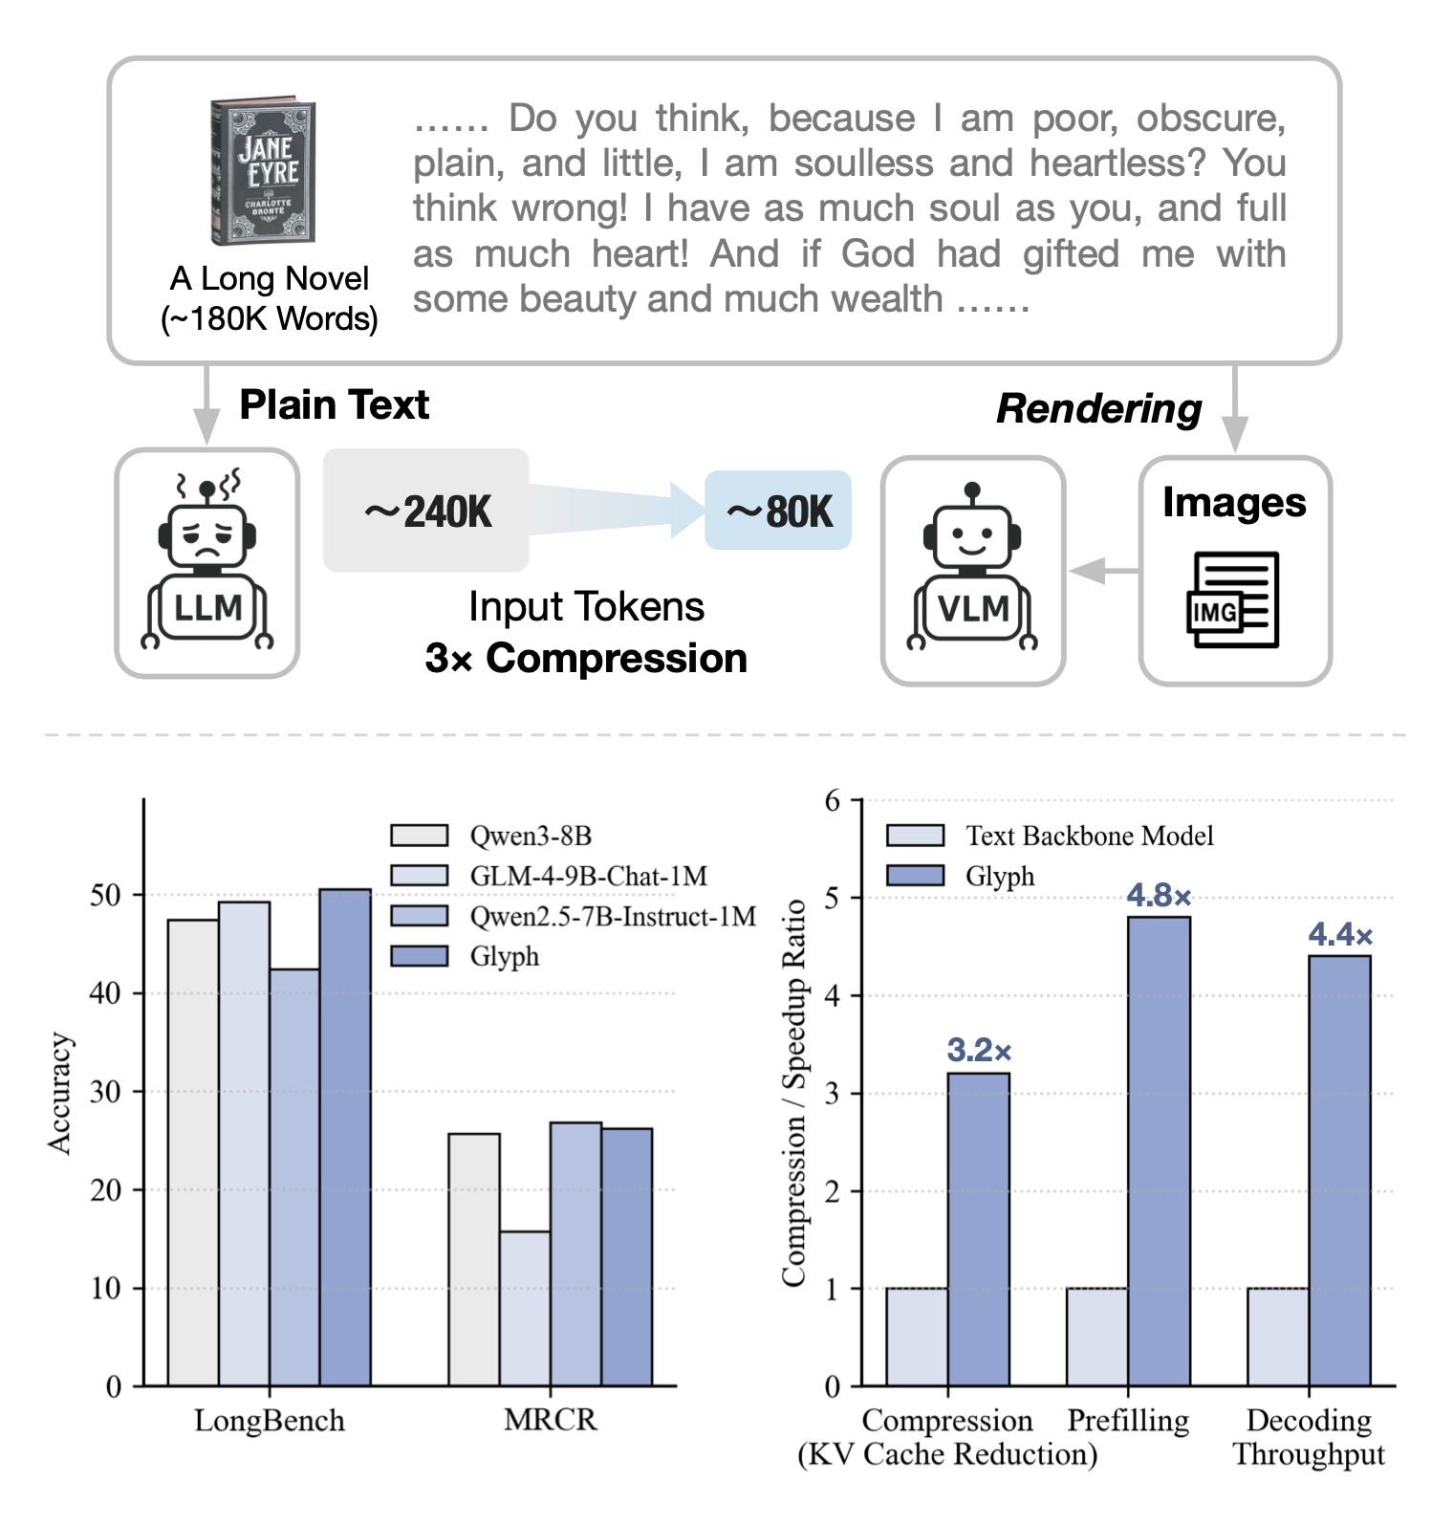
Glyph: Introduction & Motivation
How Glyph Presents the Problem
Modern LLMs need to reason over long inputs, but compute and memory grow with sequence length, not semantic content density!
Scaling to million-token contexts is impractical due to prohibitive compute and memory; existing approaches either extend windows or prune tokens with trade-offs.
Render → VLM: Convert long text to images so each visual token aggregates many words, attacking the bottleneck by changing the representation, not just the window.
What it Proposes to Solve the Problem
Framework: A practical pipeline that renders long text to images and processes them with a VLM, enabling large effective context with fewer tokens and stable accuracy.
LLM-driven rendering search: A genetic search over fonts/layout/DPI to optimize the readability ↔ compression trade-off automatically.
Training recipe + scaling result: Continual pre-training on rendered corpora → post-training (SFT/RL) with an auxiliary OCR-style loss.

Slide 9

Glyph: Demo to Motivate

Slide 10
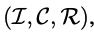
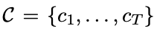
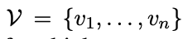
Some Basics
Any task is defined by the triplet: - I is a user instruction that specifies the core goal C, where is an ultra-long textual context.
R is target response.
Traditionally, we would do: P(R | I, C).
GLYPH: Render C as visual pages each containing glyph’s of multiple text segments. Hence, Glyph does:
P (R | I, V) and a task is defined by (I, V, R)

Slide 11
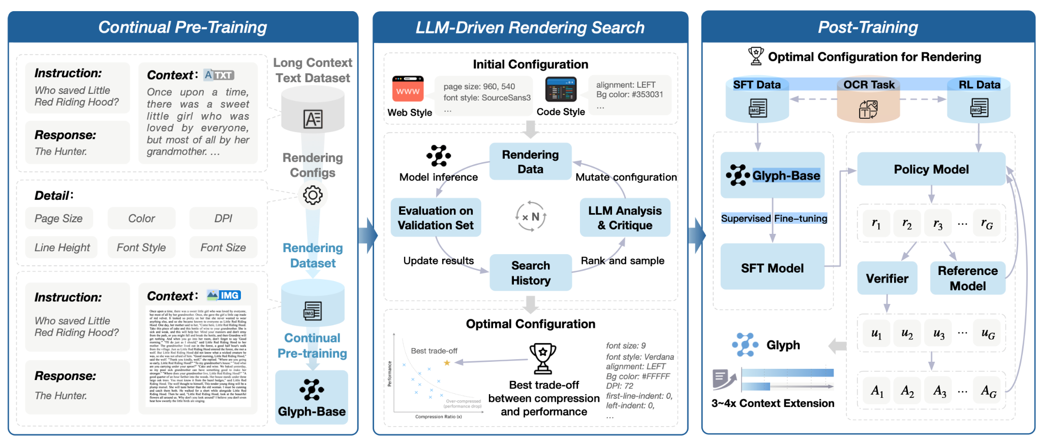
Glyph: Method

Slide 12
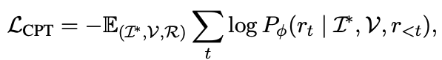
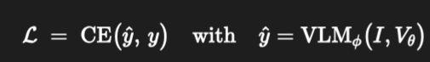
Glyph: Method
CONTINUAL PRE TRAINING
Goal: Transfer long-context from text tokens → visual tokens by exposing a VLM to massive rendered long-text with diverse typography/layout, so the model learns to read pages as compact carriers of text.
Three tasks:
OCR reconstruction: read one/many rendered pages and transcribe all text verbatim.
Interleaved LM: mix text and rendered spans and predict next tokens while switching modalities.
Generation/completion: given partial pages (beginnings/ends), complete the missing content, exercising long-range dependencies.
Gives us Glyph-Base. Where does the ‘theta’ in V come from? Those are the configs of the ‘page’ -> Next step!

Slide 13
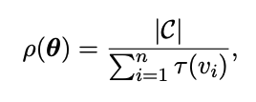
Glyph: Method
Rendering Search
Why? Remember the photos are not ‘real’ but instead generated from text. Need configs for how the photo ‘looks’.
Examples:
DPI & Page Size
Font Family and Size
Borders and Spacing
Colors
Parametrized by 𝚹. Controlling this controls compression ratio from text to vision.
Genetic Algorithm Approach
What is being evolved. A rendering genome θ. Each θ renders the same long text into images Vθ​, changing compression (visual tokens/page) vs readability.
Mutation-only evolutionary loop. Start from seed styles (web/code).
For each generation: Render, external LLM critiques outputs (where/why errors happen, readability issues), Rank & sample promising candidates, Mutate parameters.
Objective/selection signal. Keep candidates that maximize task utility under high compression, effectively searching the Pareto front between accuracy and compression ratio; the chosen θ⋆ is the best trade-off.

Slide 14
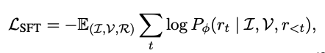
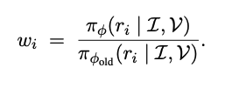
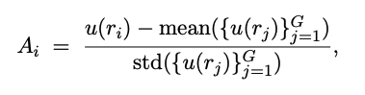
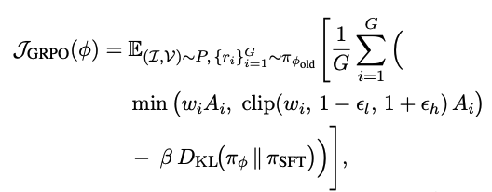
Glyph: Method
Post Training
Two tasks to improve “Glyph-Base”: Supervised FT and RL & Auxiliary OCR Alignment Task
SFT: Similar to what you would do with a Language Model except C is now V. Loss function is written as:
RL: Again, like basic LLM training, they use GRPO (C is now V). Importance sampling weight defined as:
Reward r is {0,1} integrating Verifiable Rewards and Format Rewards.
Notes:
u() is reward. Ai is Group Normalized Advantage.

Slide 15
Glyph: Method
Post Training OCR Alignment
Reconstruct all text from a generated ‘V’ and fine tune to improve on that task - similar to Continual Pre-Training Step.
They do this in both the SFT and RL Step:
For SFT - Its same as Pre-Training. Just minimize CE.
For RL - Its basic GRPO but reward is Levenshtein Distance.
Notes:
u() is reward. Ai is Group Normalized Advantage.

Slide 16
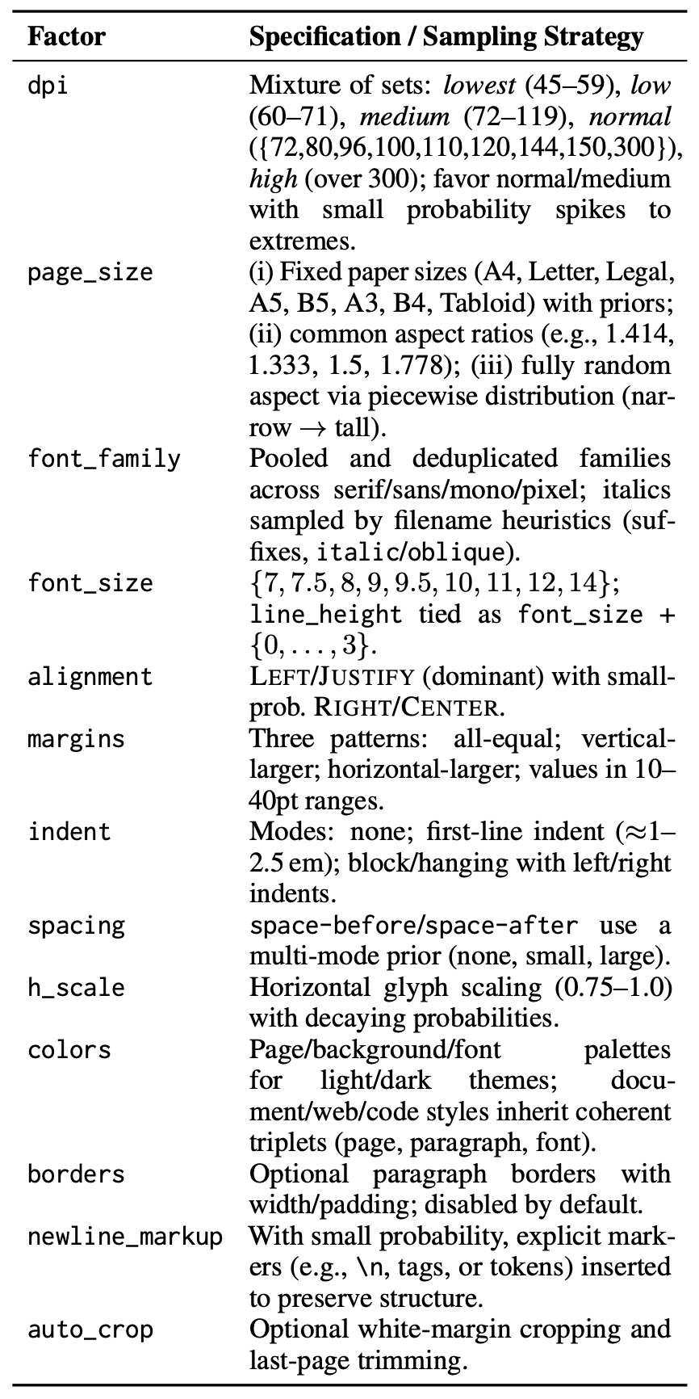
Glyph: Controllable Factors and Sampling

Slide 17
Experiments and Results

Slide 18
Glyph: Experimental Setup
Benchmarks:
LongBench: a bilingual , multitask long context understanding benchmark
MRCR: A multi-document / “needle in haystack” style long-context retrieval QA benchmark.
Ruler: long-context benchmark with various sub-tasks including UUID recognition etc (where they ignore the UUID recognition.
MMLongBench‑Doc: A long document understanding benchmark (multimodal PDF documents with images/layout) used for cross-modal generalisation.
Backbone VLM: GLM‑4.1V‑9B‑Base

Slide 19
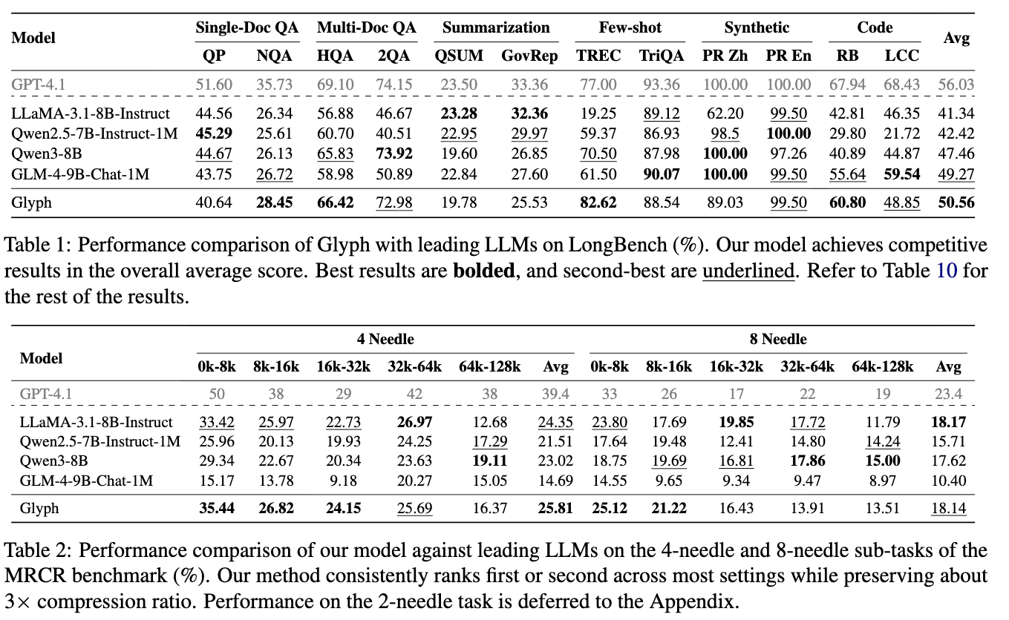
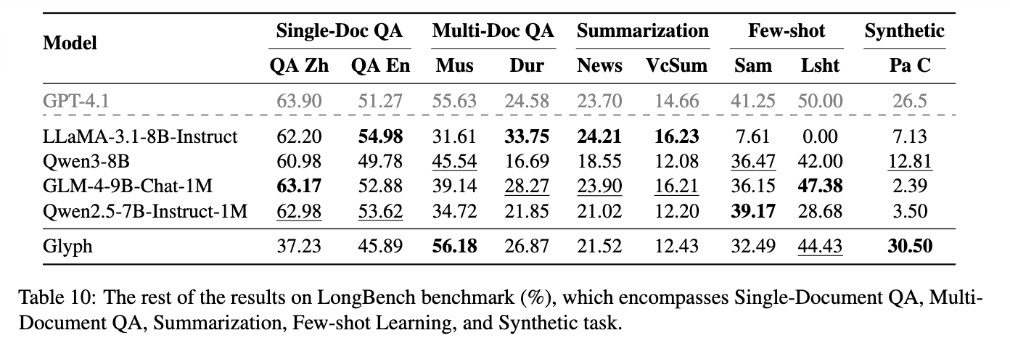
Glyph: Results
Main performance on LongBench => Matches GPT-4.1
(And in Appendix the rest results)
More degradation in Single-Doc QA (Glyph has a more blurry understanding?)
and summarization.

Slide 20
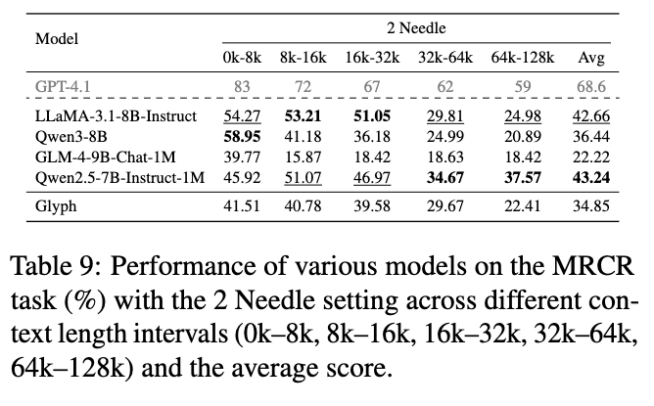
Glyph: Results
Main performance on MRCR => small gap below GPT-4.1 match open-source.
2 needle is less performant (so they defer to appendix and didn’t explain why)

Slide 21
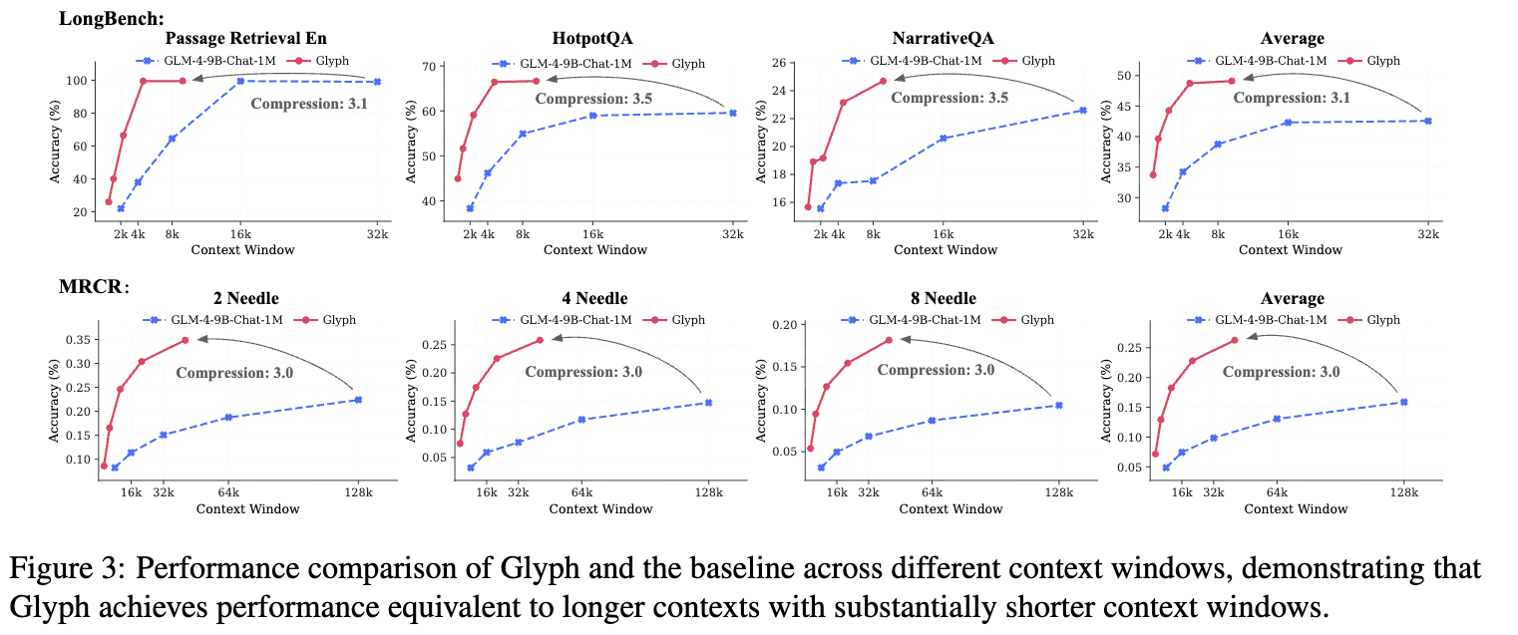
Compression Ratio

Slide 22
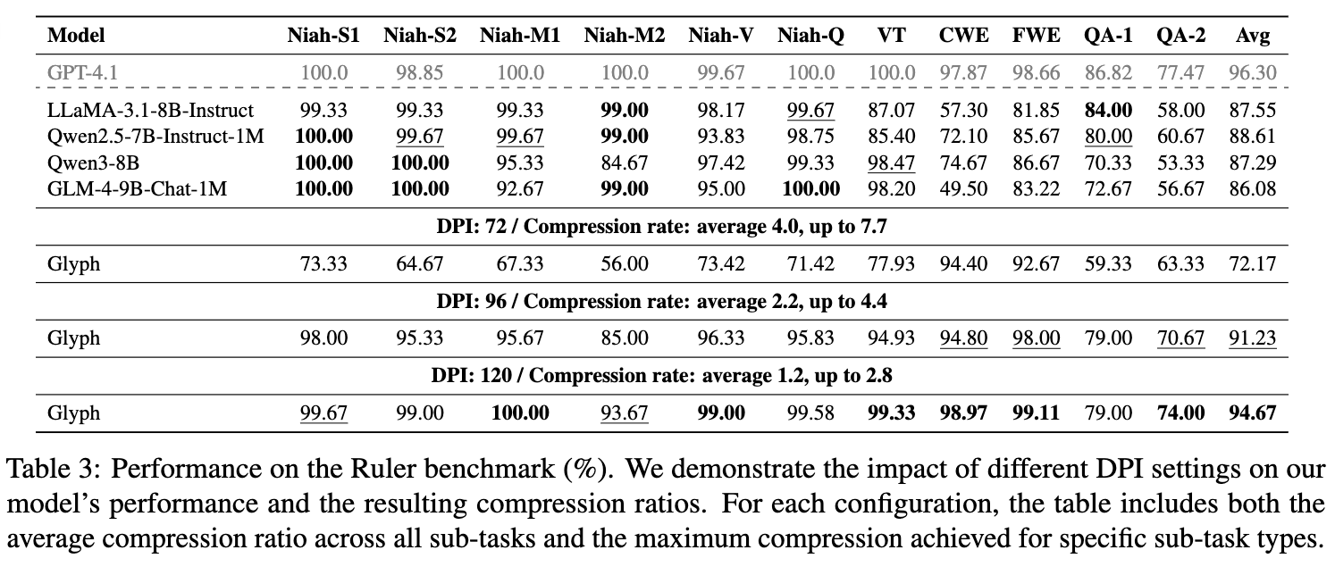
Varying Compression Ratio.
Higher DPI → larger rendered doc → More 14*14 pixel patch → More visual token.

Slide 23
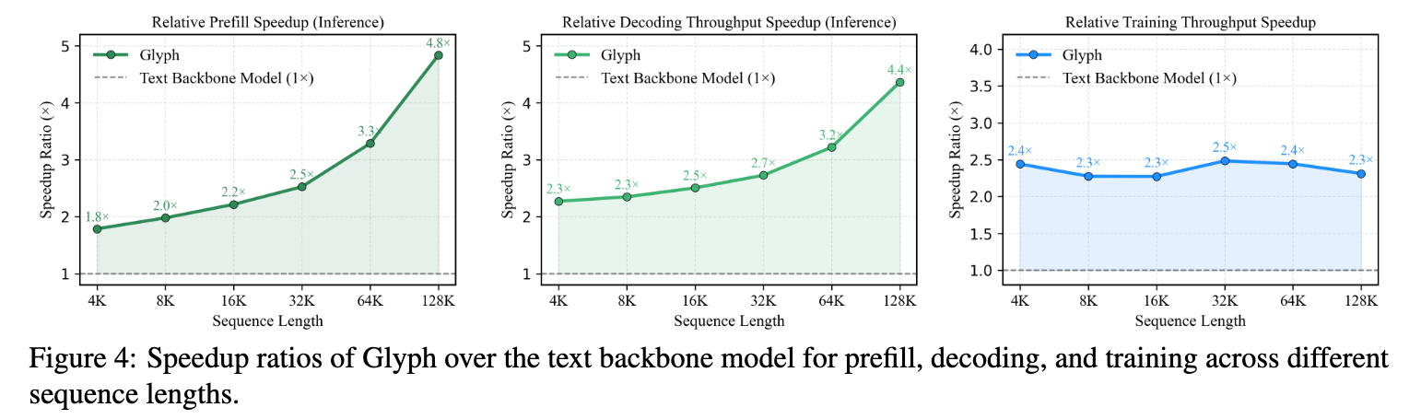
Efficiency

Slide 24
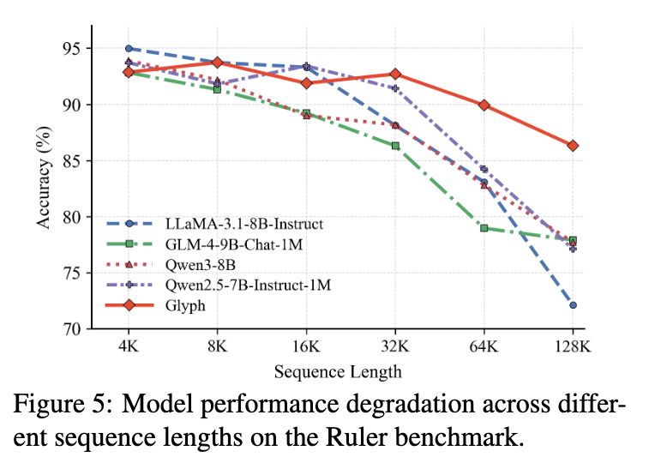
As context grow…
Glyph has slower degradation.
(what about making axis the number of token? Is the degradation tied deeply to the attention mechanism - some retrieval efficiency upper bound)

Slide 25
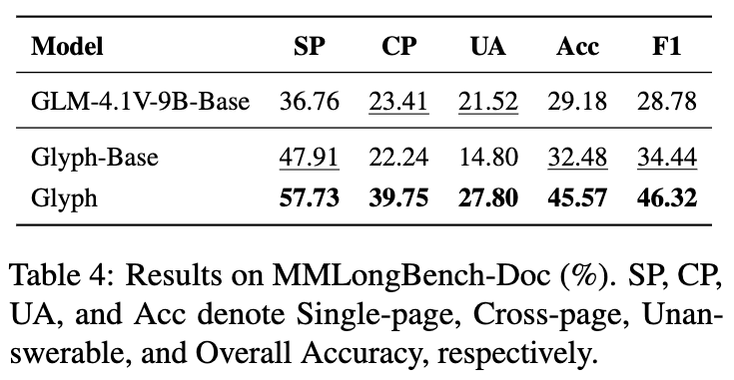
Better than base VLM
On MMLongBench-Doc (multimodal document understanding)
The full Glyph version outperform Base VLM.
→ Cross modality post-training/RL actually improves model’s ability.

Slide 26
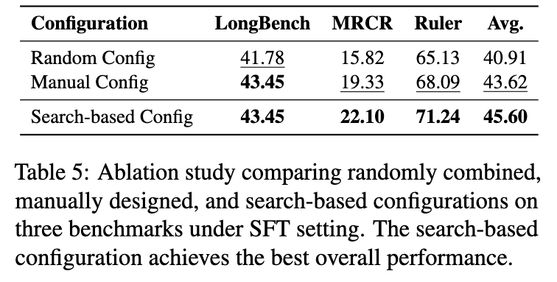
Ablation: Is Genetic Search necessary

Slide 27
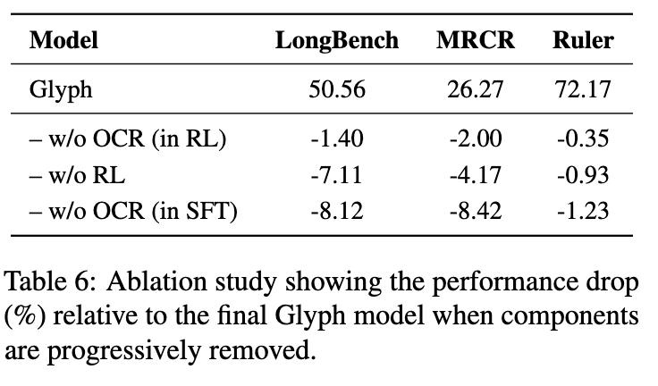
Ablation: Is Aux. Objective necessary

Slide 28
Limitations
Sensitivity to rendering parameters.
Model’s performance noticeably affected by rendering configurations such as resolution, font, and spacing.
OCR-related challenges.
UUID task especially challenging. (quote - even the strongest models [e.g., Gemini-2.5-Pro] often fail to reproduce them correctly.)
Task diversity.
More tasks besides long-context understanding.
e.g. agentic, reasoning.
“We also observe that, compared with textual models, the visual-text model tends to generalize less effectively across tasks”

Slide 29
Questions?
Is patch based visual token necessary or sufficient? (What are we actually gaining through using VLM, is it just a dense tokenization that encompass multiple token. )

Slide 30
DeepSeek-OCR: Contexts Optical Compression

Slide 31
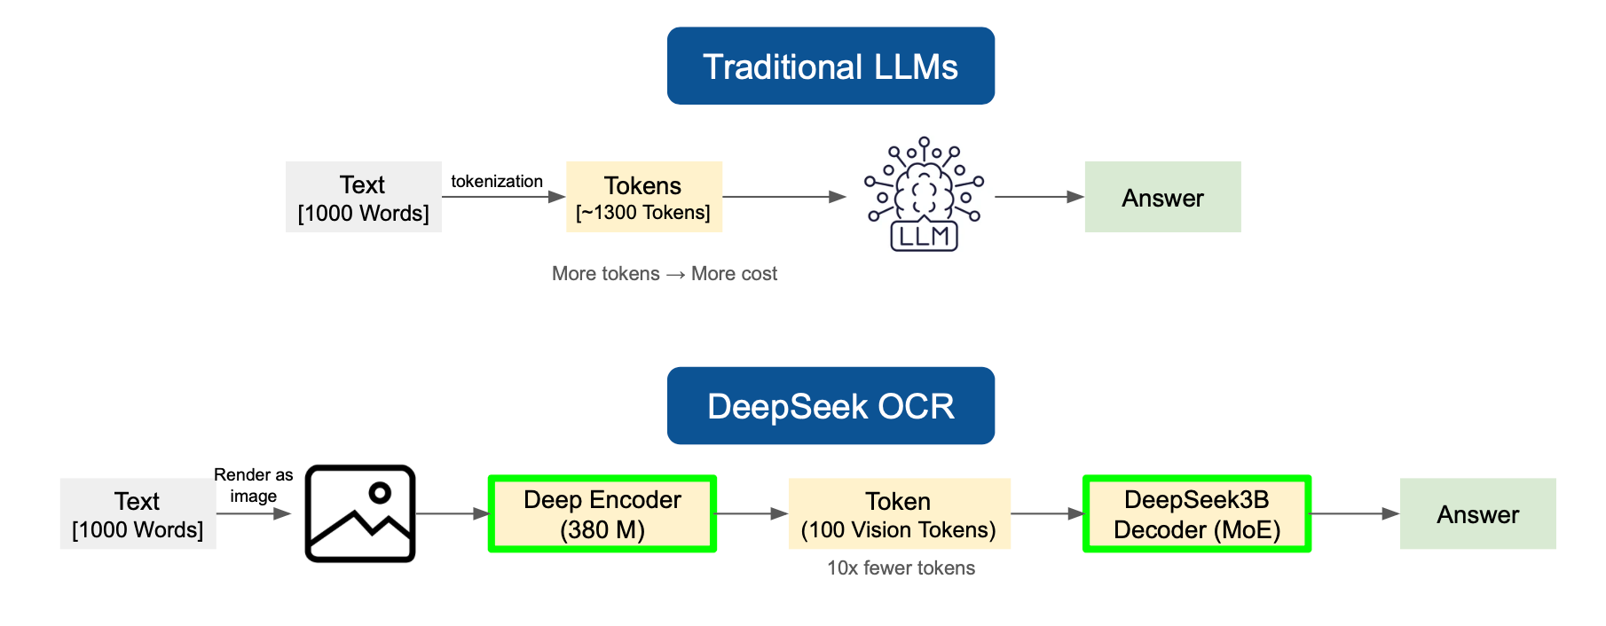
DeepSeek-OCR: Introduction & Motivation
Significant compute challenges with long textual content.
One solution: use single image containing document text → rich information while using substantially fewer tokens.
OCR tasks establish natural compression-decompression mapping between visual and textual representations
Motivated DeepSeek-OCR
DeepSeek-OCR: A Picture is Worth a Thousand Words, Towards AI (2024)
https://pub.towardsai.net/deepseek-ocr-a-picture-is-worth-a-thousand-words-e2a8b9d74c7f
Notes:
Current LLMS face significant compute challenges w long textual content.
One such solution is using a single image containing document text, able to represent rich info while using subs tantially fewer tokens than the digital version.

Slide 32
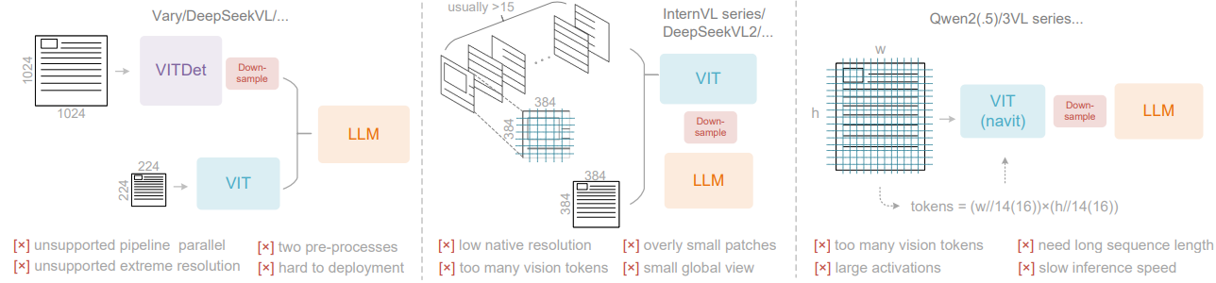
DeepSeek-OCR: Introduction & Motivation
Types of Vision Encoders in current VLMs:
Dual-tower architecture: two parallel encoders
Tile-based method: split image into small tiles
Adaptive-resolution encoder: process full image using patch segmentation
One question not addressed: What is the least amount of vision tokens we need to decode a document of x words?
Notes:
Types of Vision Encoders in current VLMs:
Dual-tower architecture (e.g., Vary)
Uses two parallel encoders (like SAM) to process high-resolution images.
Pros: lets you control model size and activation memory.
Cons: needs two image preprocessing steps, which makes training and deployment complex and slow (hard to parallelize).
Tile-based method (e.g., InternVL2.0)
Splits large images into many small tiles, then processes them in parallel
Pros: lowers activation memory, can handle very high-resolution images
Cons: breaks images into too many fragments → produces lots of vision tokens; native encoder resolution is small (≤ 512×512), so overall efficiency drops.
Adaptive-resolution encoder (e.g., Qwen2-VL / NaViT style)
Processes entire images directly using patch segmentation instead of tiling.
Pros: flexible — works with images of many different sizes.
Cons: needs huge activation memory (risk of GPU overflow) and very long token sequences, which slows both training and inference.
Each of these encoders struggles with efficiency so DeepSeek designed DeepEncoder to process high-resolution text images with minimal tokens and memory.

Slide 33
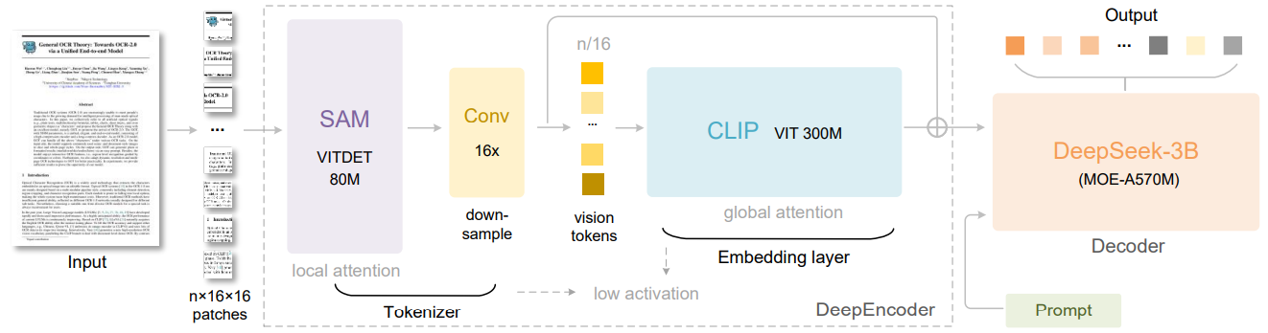
DeepSeek-OCR: Methodology
Encoder three part architecture:
SAM base
2 layer convolutional model (downsampler)
CLIP
DeepSeek-3B MoE Decoder
Notes:
SAM → Adaptive-resolution-style encoder with windowed attention rather than dense global attention

Slide 34
DeepSeek-OCR: Methodology
Segment Anything Model (SAM) base: vision model designed to separate/segment regions or objects in an image and extract visual perception features.
Breaks image into 16x16 patches and creates local feature tokens to then be sent into downsampling module → Downsampler reduces number of vision tokens
Notes:
SAM → Adaptive-resolution-style encoder with windowed attention rather than dense global attention

Slide 35
DeepSeek-OCR: Methodology
CLIP: Embedding layer with global attention
Vision Encoder that learns to connect images and text.
The downsampled tokens are fed into CLIP which applies dense global attention, how pieces fit together as “text”
Notes:
CLIP is a pretrained vision-language model originally designed to connect images and text. It learns a shared embedding space where similar images and text sit close together.
CLIP looks at the entire image at once, helping the model understand how all the visual pieces from SAM fit together

Slide 36
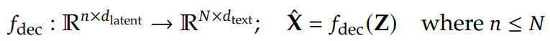
DeepSeek-OCR: Methodology
During inference, model activates 8 out of 64 experts (specialized sub-networks)
Z are the compressed latent (vision) tokens from DeepEncoder
X̂ hat is the reconstructed text representation.
ƒ_{dec} is a non linear mapping that can be learned.

Slide 37
DeepSeek-OCR: Data
OCR 1.0 data: ~30M PDF pages + natural scene text (English, Chinese, ~100 languages)
OCR 2.0 data: synthetic charts, geometry, and chemical formulas for structured parsing
General vision data: small portion of image-caption, grounding, detection
Text-only data: 10% of training to maintain language modeling ability
Notes:
They constructed a dataset for DeepSeek-OCR, including OCR 1.0 data (scene image OCR and document OCR), OCR 2.0 data (parsing tasks for complex artificial images such as chemical charts), general vision data
OCR 1.0 data:
We collect 30M pages of diverse PDF data covering about 100 languages from the Internet
OCR 2.0 data:
we refer to chart, chemical formula, and plane geometry parsing data
General Vision Data:
we generate relevant data for tasks such as caption, detection, and grounding
Only 20% of total data
Text-only data:
10% of in-house text-only pretrain data

Slide 38
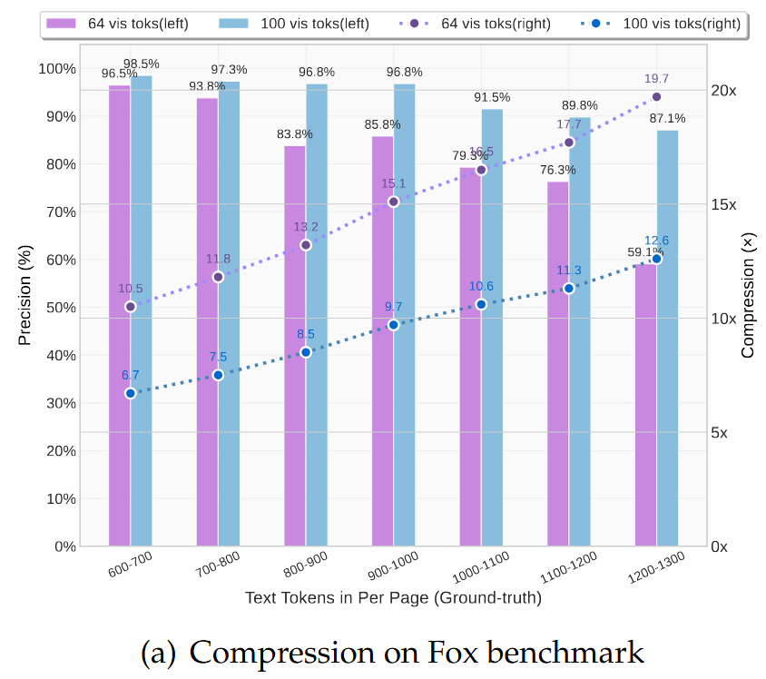
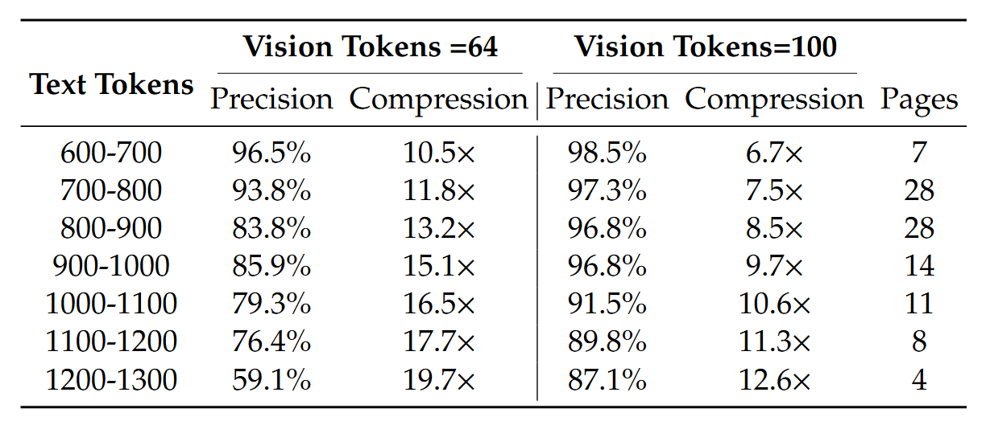
DeepSeek-OCR: Results
97% OCR precision with text compressed by up to 10 times.
60% OCR precision even at a 20x text compression ratio
Promising for handling long context

Slide 39
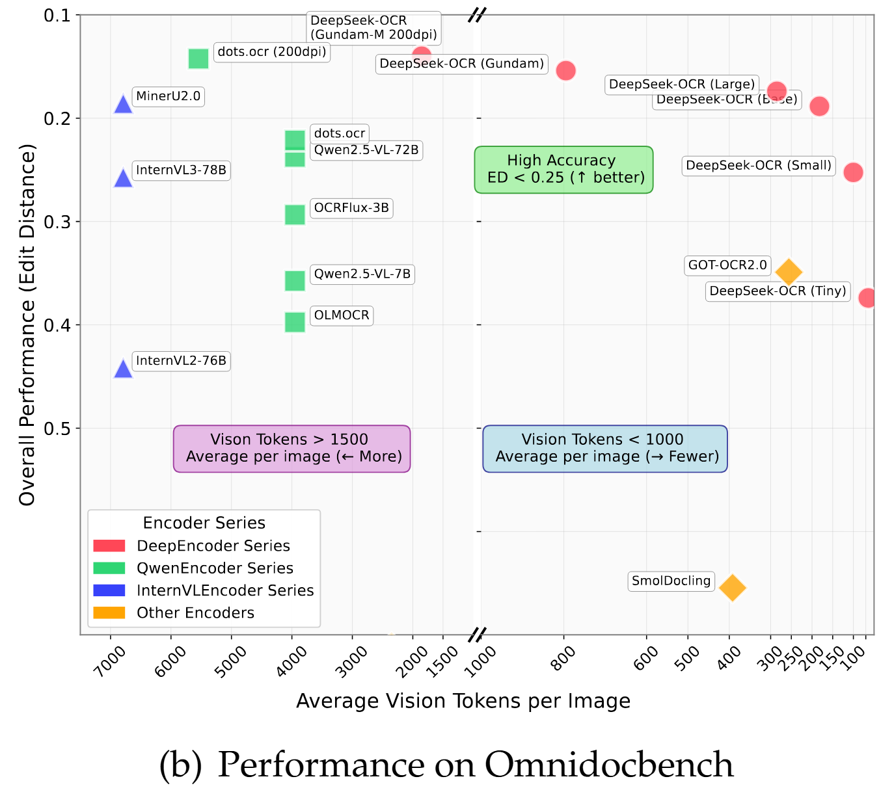
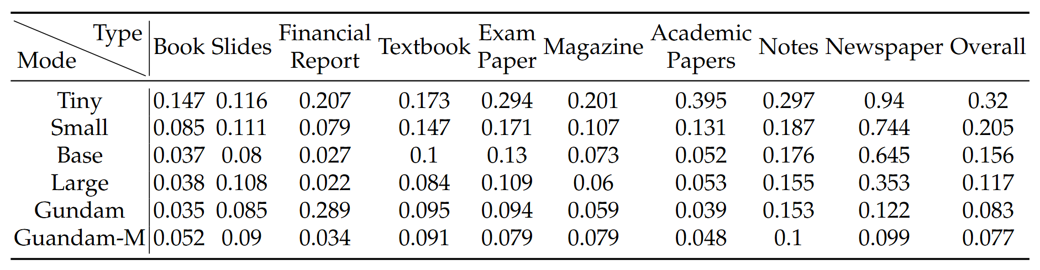
DeepSeek-OCR: Results
Achieves better performance with less token needed compared to other model.
Shows adaptive performance for diverse content.
Edit distances for different categories of documents in OmniDocBench

Slide 40
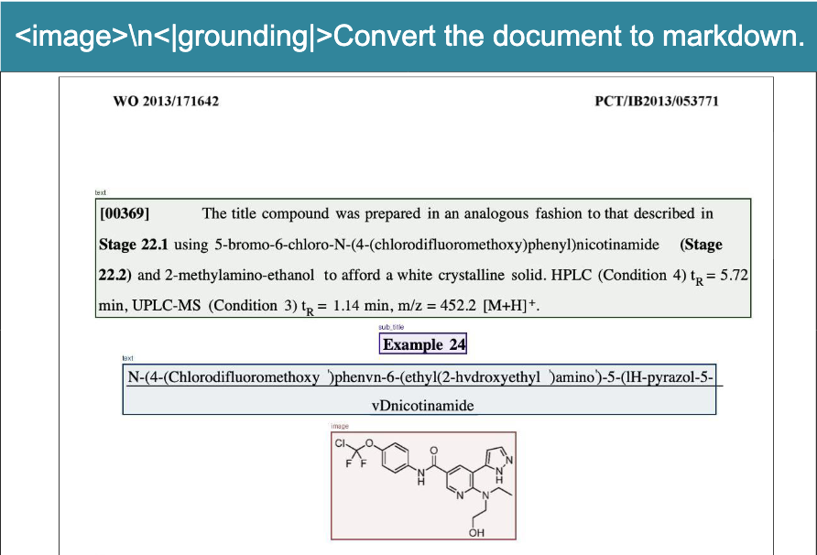
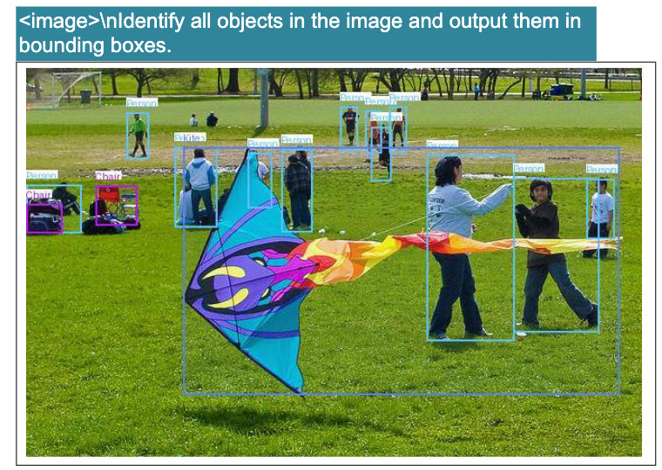
DeepSeek-OCR: Results
Deep Parsing: Extracts structured data from non-textual visual elements, such as converting text into Markdown, chemical formulas into SMILES strings, and geometric figures into structured data.
Multilingual Recognition: Supports nearly 100 languages in PDF documents.
General Vision Understanding: Describing image, object detection, grounding, etc.

Slide 41
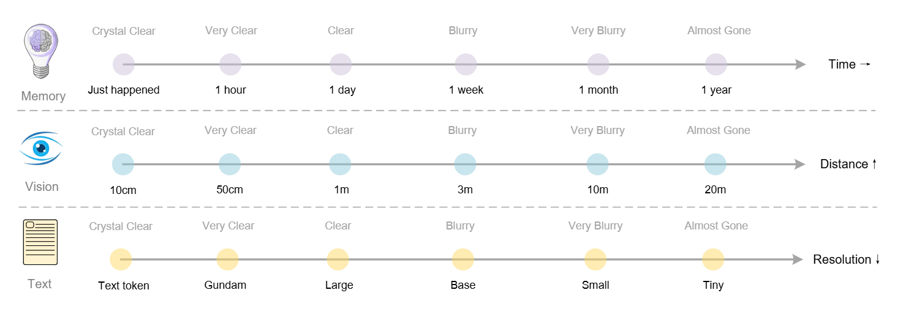
DeepSeek-OCR: Discussion
Simulates human memory forgetting by blurring and reducing tokens for older visual contexts, allowing distant memories to naturally fade.
Enables scalable, theoretically unlimited context architectures.

Slide 42
Questions?

